Slide 1
Data Coding & Editing
Module 4.3

Slide 2







  Code
Data needs to be edited, coded, and entered in a computer, before moving to analysis.
  Edit
  Error Checking & Verification
  Enter
  Analyze
Making Data Ready for Analysis

Slide 3
This Module Discusses…
Data Editing
Data Coding
Data Entry

Slide 4
Data Editing
First Step in Analysis

Slide 5
Data Editing
The customary first step in analysis is to edit the raw data.
Editing detects errors and omissions, corrects them when possible, and certifies the maximum data quality standards are achieved.
The purpose is to guarantee that data are accurate, consistent with the intent of the question and other information in the survey, uniformly centered, complete, and arranged to simplify coding and tabulation.

Slide 6
Data Editing
Data Editing
Field Editing
Central Editing
Editing data as soon as it is collected. Commonly done when data is collected using interviews.
Editing data at a later time, in an office location. Commonly done when questionnaires are used.

Slide 7
Data Editing - Guidelines
Be familiar with instructions given to interviewers and coders
Do not destroy the original entry
Make all editing entries identifiable and in standardized form
Initial all answers changed or supplied
Place initials and date of editing on each instrument completed

Slide 8
Data Coding
Assigning Numbers to Responses

Slide 9
Data Coding
Coding involves assigning numbers or other symbols to answers so that the responses can be grouped into a limited number of categories.
In coding, categories are the partitions of a data set of a given variable. For instance, if the variable is gender, the categories are male and female.
Categorization is the process of using rules to partition a body of data. Both closed and open questions must be coded.

Slide 10
Codebook
A codebook contains each variable in the study and specifies the application of coding rules to the variable.
It is used by the researcher or research staff to promote more accurate and more efficient data entry.
It is the definitive source for locating the positions of variables in the data file during analysis.

Slide 11
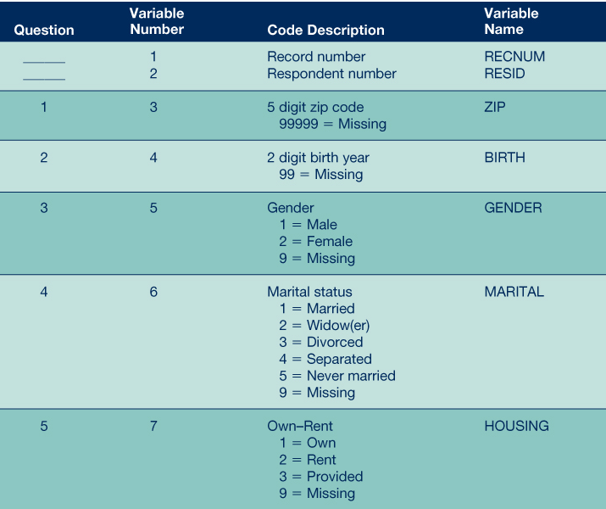
Sample
Codebook

Slide 12
Collectively Exhaustive
Mutually exclusive
Rules for Creating Coding Categories
Appropriate to the research problem
Derived from one classification principle

Slide 13
Data Entry
The Last Step Before Moving to Analysis

Slide 14
Data Entry
Data entry converts information gathered by secondary or primary methods to a medium for viewing and manipulation.
Keyboarding remains the primary method. However, new methods are making data entry more efficient.
  Database Programs
  Optical/Voice Recognition
  Digital/Barcodes

Slide 15
Don’t Know & Missing Responses
absence of useful data when respondents indicate their lack of awareness (don’t know) or refuse to respond (missing response) to a particular question.

Slide 16
Don’t Know Responses
When the number of “don’t know” (DK) responses is low, it is not a problem.
However, if there are several given, it may mean that the question was
  poorly designed,
  too sensitive, or
  too challenging for the respondent.

Slide 17
Handling Don’t Know Responses
Questionnaire Design
  The best way to deal with undesired DK answers is to design better questions at the beginning.
Separate Category
  If DK response is legitimate, it should be kept as a separate reply category.

Slide 18
Missing Responses
Missing data are information from a participant or case that is not available for one or more variables of interest.
Missing data typically occur in surveys
  when respondents accidentally skip, refuse to answer, or do not know the answer to an item on the questionnaire.
  when researcher error corrupts data files.

Slide 19
Handling Missing Data
List-wise Deletion
  cases with missing data on one variable are deleted from the sample for all analyses of that variable.
Pair-wise Deletion
  missing data are estimated using all cases that have data for each variable or pair of variables; the estimation replaces the missing data.
Predictive Replacement
  missing data are predicted from observed values on another variable; the observed value is used to replace the missing data.

Slide 20
  Code
  Edit
  Error Checking & Verification
  Enter
After data has been cleaned and entered in the system, it is ready to be analyzed. A researcher needs to select analysis tools and techniques that will help achieve the research objectives.
  Analyze

Slide 21
A lot of effort goes into transforming data into meaningful results.
Collected data needs to be edited, coded, and entered in a computer, before moving to analysis.
  Editing involves the inspection and, if necessary, correction of each questionnaire. Editing ensures data quality, by detecting and correcting errors.
  Coding involves assigning numbers or other symbols to answers so that the responses can be grouped into a limited number of categories.
  Data entry is the last step before moving to analysis. It involves converting physical data into digital form. The main benefit of entering data into computers is to perform analysis.
Although some number of missing and don’t know responses are common, it should not be the majority of your collected data.
After data has been cleaned and entered in the system, it is ready to be analyzed. There are several statistical techniques that one can use, depending on the research objectives.
In Summary

